Slide 1
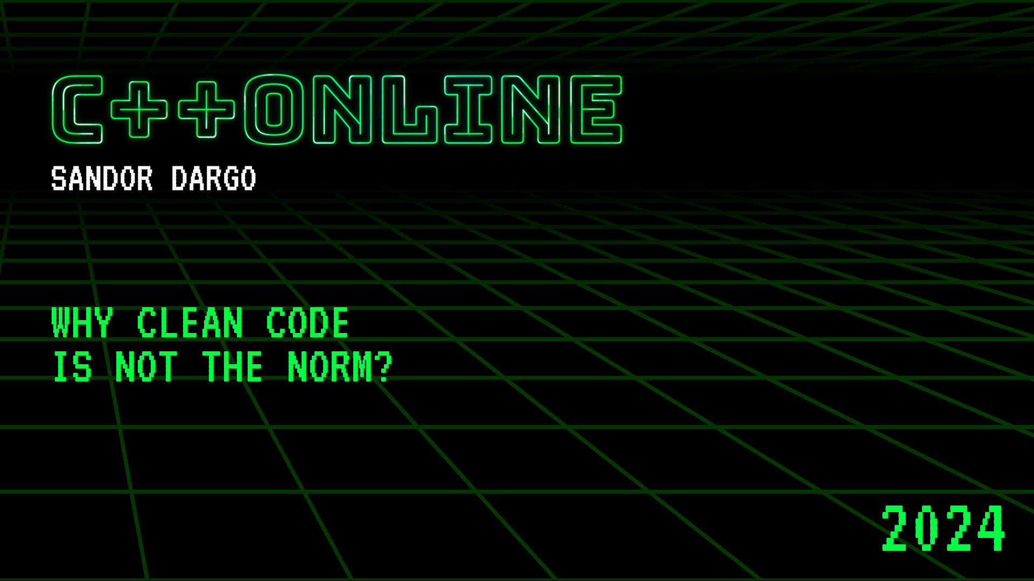

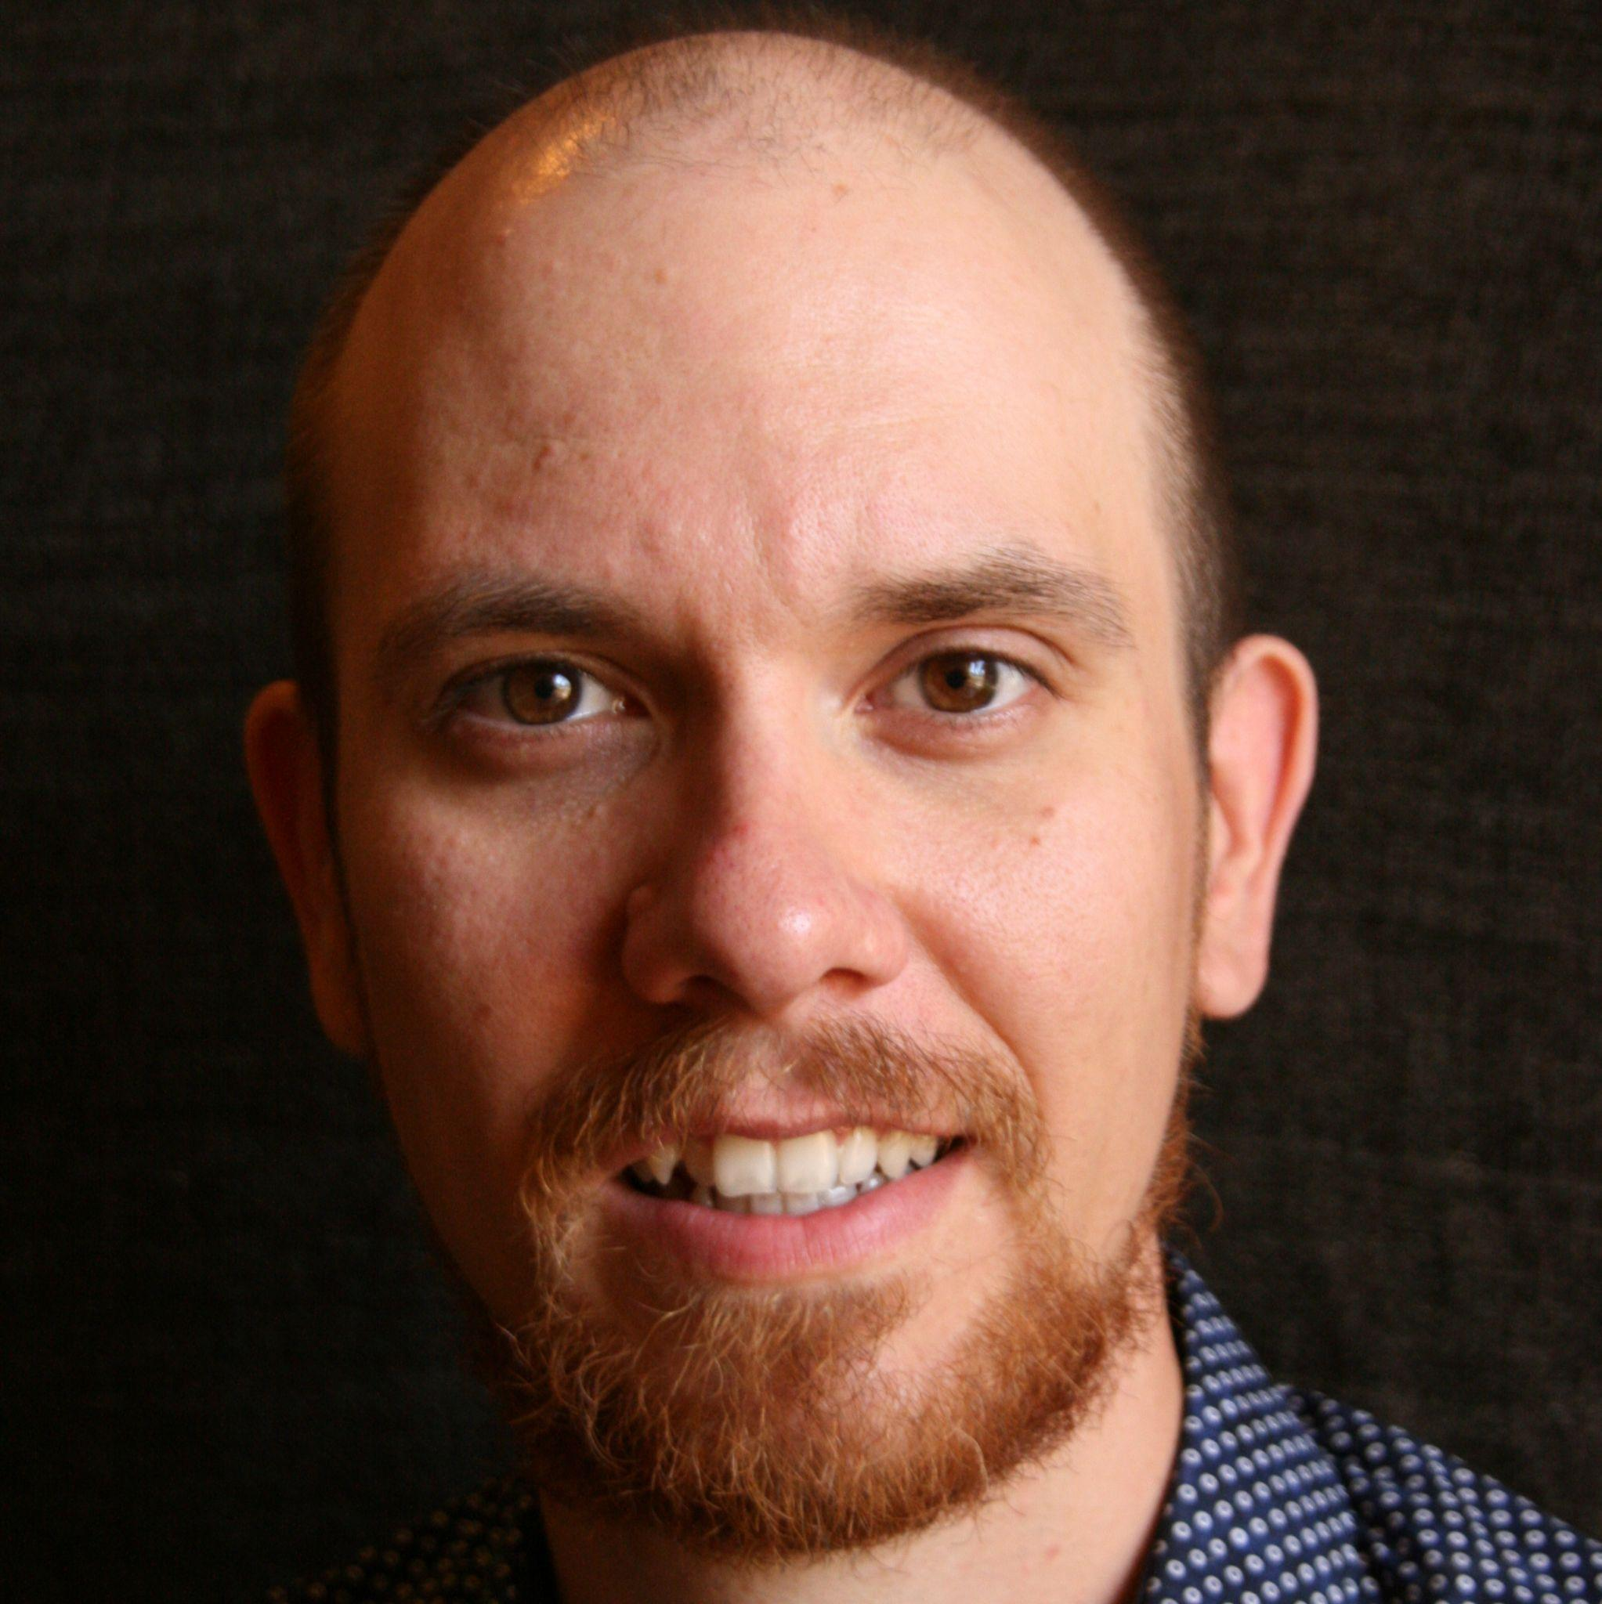

Why Clean Code Is Not The Norm?
Sandor Dargo
T W I T T E R SandorDargo E M A I L sandor.dargo@gmail.com
Notes:
Main points are:
What is software quality & clean code
Their relationship
What can we do about them

Slide 2
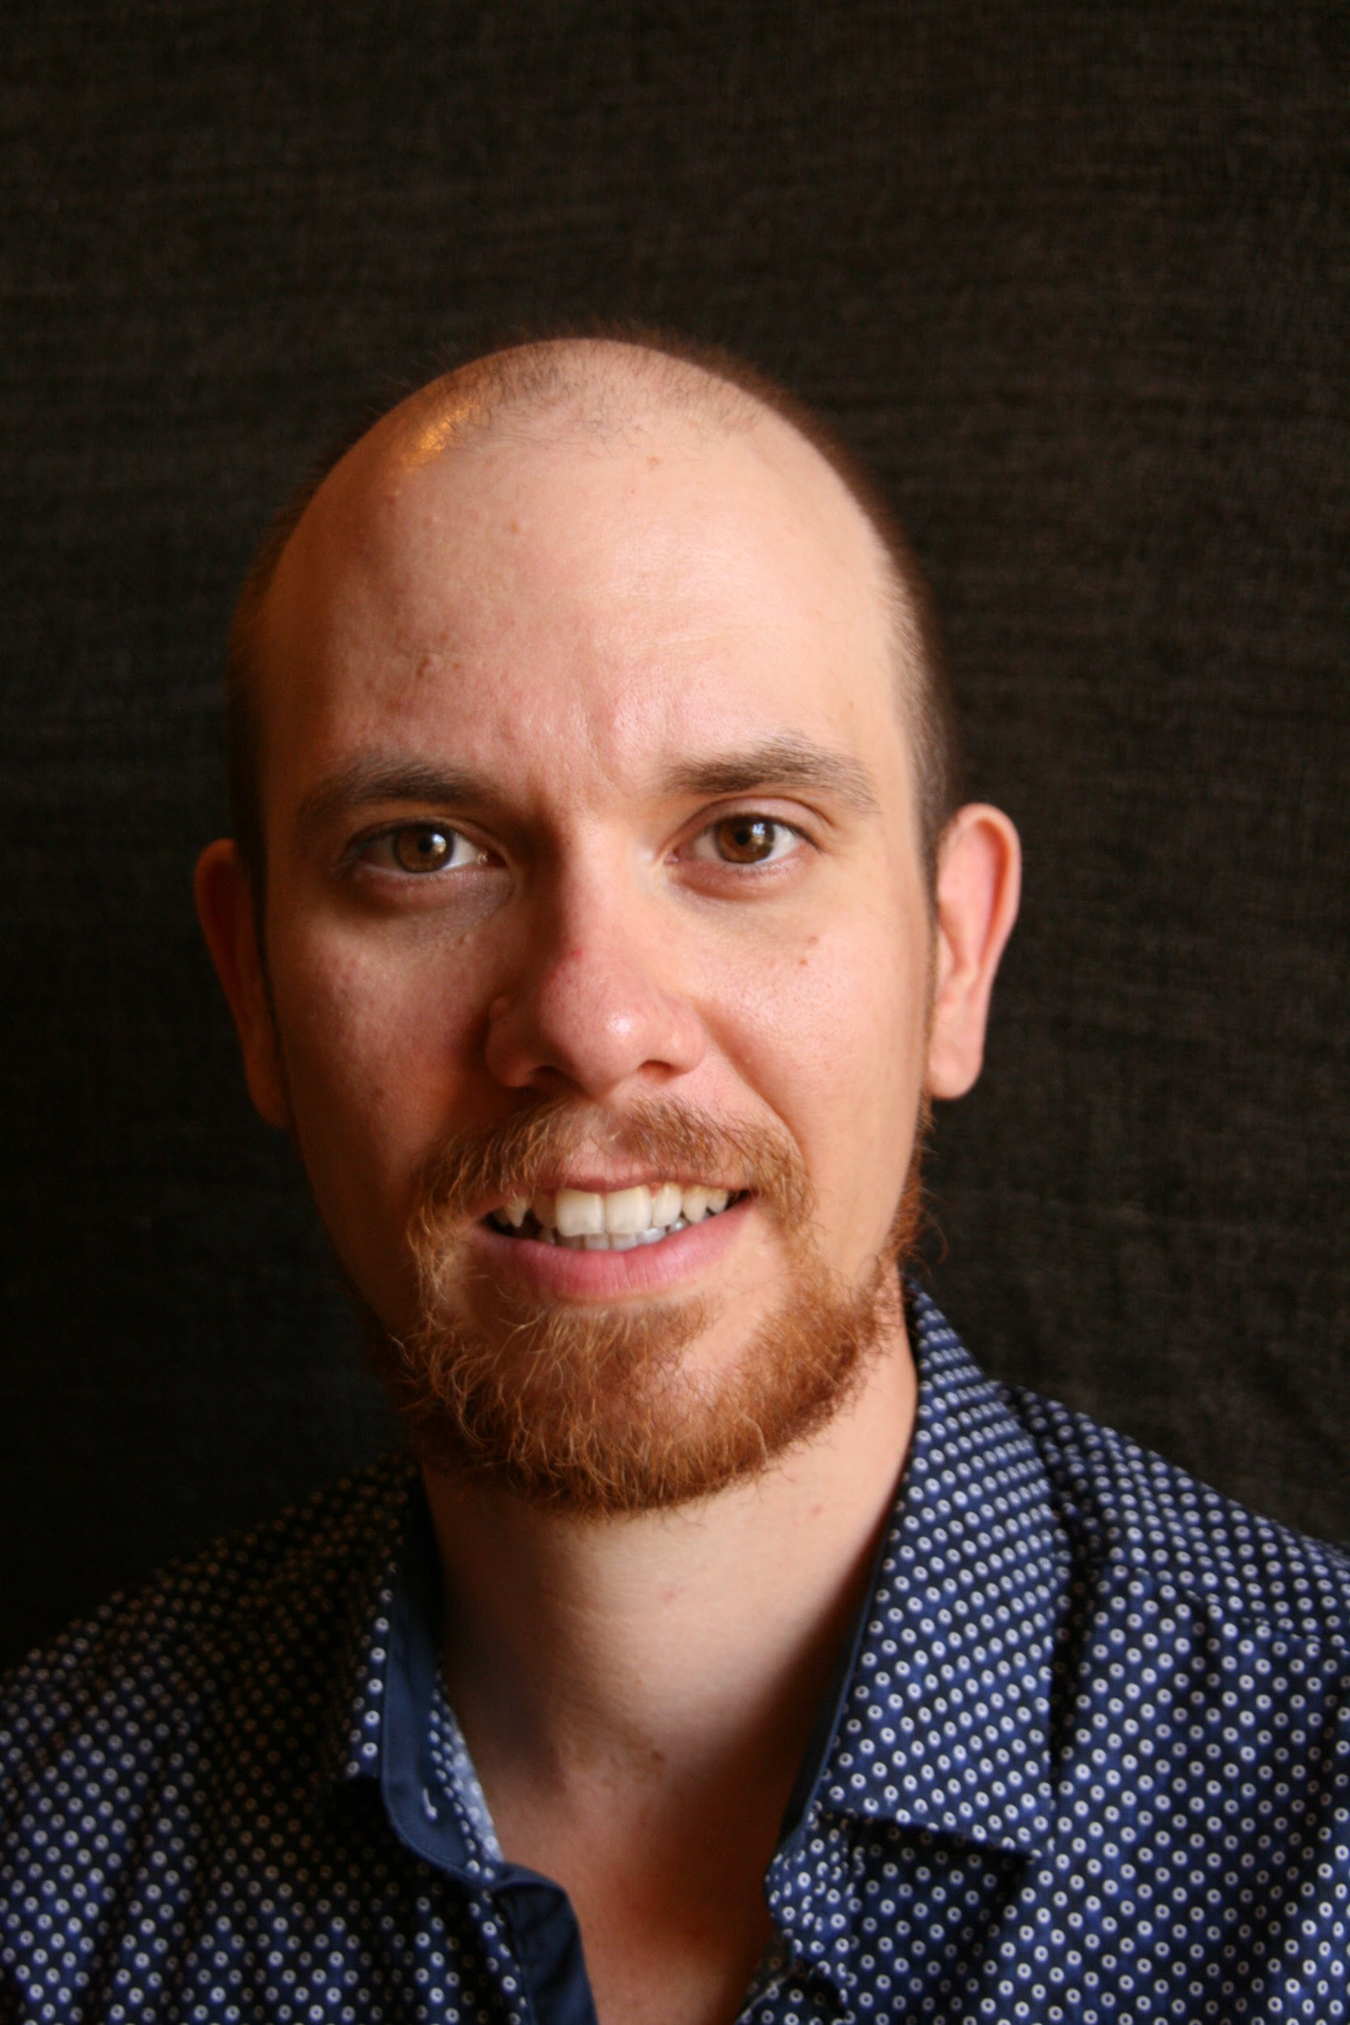
Who Am I?
Sándor DARGÓ
Senior Engineer at Spotify
Enthusiastic blogger: sandordargo.com
Passionate traveller
Keen epicure
Fortunate father of two
Notes:
‹#›

Slide 3
Agenda
What is software quality?
What is clean code?
How do they relate to each other?
Why don’t we write clean code?
What is our job?

Slide 4
Why this talk?
Clean code is not the “de facto standard”
Developers cannot agree on what quality is
People prefer blaming others vs. taking responsibility

Slide 5
Is clean code part of software quality?
Notes:
ASK THEM!

Slide 6
What is software quality?

Slide 7
Is software quality a meaningful term?
It is NOT, according to Derek Jones (The aura of software quality)
Software quality means something different to everyone
Therefore it’s a meaningless marketing term
Notes:
"Evidence-based Software Engineering: based on the publicly available data",
Talk about Phil Nash’s presentation CISQ
How his definition …
People in industry are very interested in software quality, and sometimes they have the confusing experience of talking to me about it. My first response, on being asked about software quality, is to ask what the questioner means by software quality. After letting them fumble around for 10 seconds or so, trying to articulate an answer, I offer several possibilities (which they are often not happy with). Then I explain how “software quality” is a meaningless marketing term. This leaves them confused and unhappy. People have a yearning for software quality which makes them easy prey for the snake-oil salesmen.

Slide 8
Quality is undefinable
You recognize it when you see it
Notes:
We can share different attributes
A car is HQ because it never breaks down. But isn’t it just reliable?
A car is HQ because it’s fast. But isn’t it just fast?
A car is HQ because it uses expensive materials? But isn’t it just luxurious?
What is a fast car that uses expensive materials but that breaks down and catches on fire? Is it HQ?
These are still just characteristics.

Slide 9

Two approaches to quality
Classical quality
The engineering aspect
How things work
Romantic quality
How things are used
(External) Design, aesthetics
Notes:
https://events.hubilo.com/meeting-cpp-2021/session/107541
inorganic, biological, social, and intellectual, leaving dynamic quality undefinable.

Slide 10
What is software quality?
ISO: Software quality is "capability of a software product to conform to requirements" while for others it can be synonymous with customer- or value-creation or even defect level.
ASQ: Software quality describes the desirable attributes of software products. There are two main approaches exist: defect management and quality attributes.
Tom DeMarco: a product's quality is a function of how much it changes the world for the better.
More definitions at Wikipedia...
Notes:
Colour code for romantic/classic
TOM DE MARCO, peopleware, Structured Analysis and System Specification.

Slide 11

defines the 4 pillars of structural quality
Security
Reliability
Maintainability
Performance efficiency
Clearly a classical approach
Notes:
Romantic or classic?
quality a meaningless marketing term
Quality is undefinable - you recognize it when you see it

Slide 12
What is clean code?

Slide 13
Code that is easy to understand and easy to change
Notes:
We can share different attributes
A car is HQ because it never breaks down. But isn’t it just reliable?
A car is HQ because it’s fast. But isn’t it just fast?
A car is HQ because it uses expensive materials? But isn’t it just luxurious?
What is a fast car that uses expensive materials but that breaks down and catches on fire? Is it HQ?
These are still just characteristics.

Slide 14
It should be easy to understand the …
Execution flow
Object relationships
Roles and responsibilities
Purpose of each expression
Notes:
https://garywoodfine.com/what-is-clean-code/

Slide 15
Code is easy to change when …
Classes have concise public interfaces
The code is easily testable and has unit tests
Classes and methods are predictable and work as expected
Classes and methods are small and only have a single responsibility
Notes:
When or in which circumstances?

Slide 16
Is clean code part of software quality?
For some, no…
As long as the code works without bugs it’s OK
The user doesn’t see it anyway
It’s simply fun for devs
Yet, not everyone finds it amusing
For others, yes!
Helps reduce the number of bugs (SRM)
Helps reduce the time to fix bugs (RM)
Decreases maintenance costs (M)
It’s part of making a job right
Notes:
Well, we haven’t talked about performance efficieny
Helps… which characteristic of CISQ?
Number of bugs:
Reliability
(Security)
(Performance efficiency)
Time to fix
Maintainability
Maintenance costs:
Maintainability

Slide 17
But wait, what about performance?

Slide 18
Performance matters…
…sometimes
And it’s not always runtime performance
Especially not due to algorithmic complexity
First make it right, then optimize
Unless, you have some special criteria

Slide 19
Why clean code is often expendable?
Notes:
This needs another subtitle…

Slide 20

Clean code is costly!
Attention
Effort
Care
Time
Not costs that the business is usually ready to pay
Notes:
I don’t really like this slide
https://garywoodfine.com/what-is-clean-code/
Not values that the business usually cares about

Slide 21
Quality is often lost in the midst of constraints
Moving one point impacts the other two points
Scope
The invisible “quality” is in the middle
It’s usually the first sacrifice
Quality
Time
Cost
Notes:
Make this pyramid by hand and let quality with the arrows appear separately.
I NEED TO UNDERSTAND THIS BETTER
MAKE THE TRIANGLE a PYRAMID, to show when it’s not involutanrily sacrificed
https://garywoodfine.com/what-is-clean-code/
Not values that the business usually cares about

Slide 22
No end user cares about the quality of code
They can’t care less about the
Aesthetics of code
Beauty of code
Elegance of code
Notes:
NOT EVEN IF THEY ARE USERS OF YOUR API! They want a clear API, they don’t care about the implementation details!
Bad way of presenting things!

Slide 23
Users want solutions to their problems
And they want them every single moment!

Slide 24
Why isn’t clean code l’art pour l’art?
Notes:
L’art pour l’art = self-serving

Slide 25
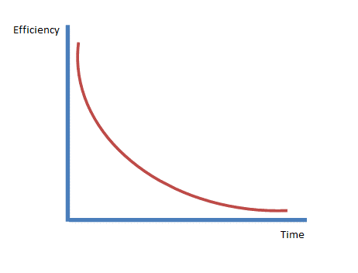
What will happen if you write ugly bad code?
It all starts with high productivity
The number of bugs increases
Productivity slows down
Then...
Notes:
We could replace this chart with something more interactive
On Time Software, company creating dev tools, such as Boreland Turbo Debugger
Successful in 90s, software became complex, new features was more and more difficult, due to poor quality
2005, out of buisness

Slide 26

Notes:
There was some interesting shit from uncle bob about a debugger maybe? What about Netscape?
"On Time Software"!

Slide 27
So, is clean code part of software quality?

Slide 28
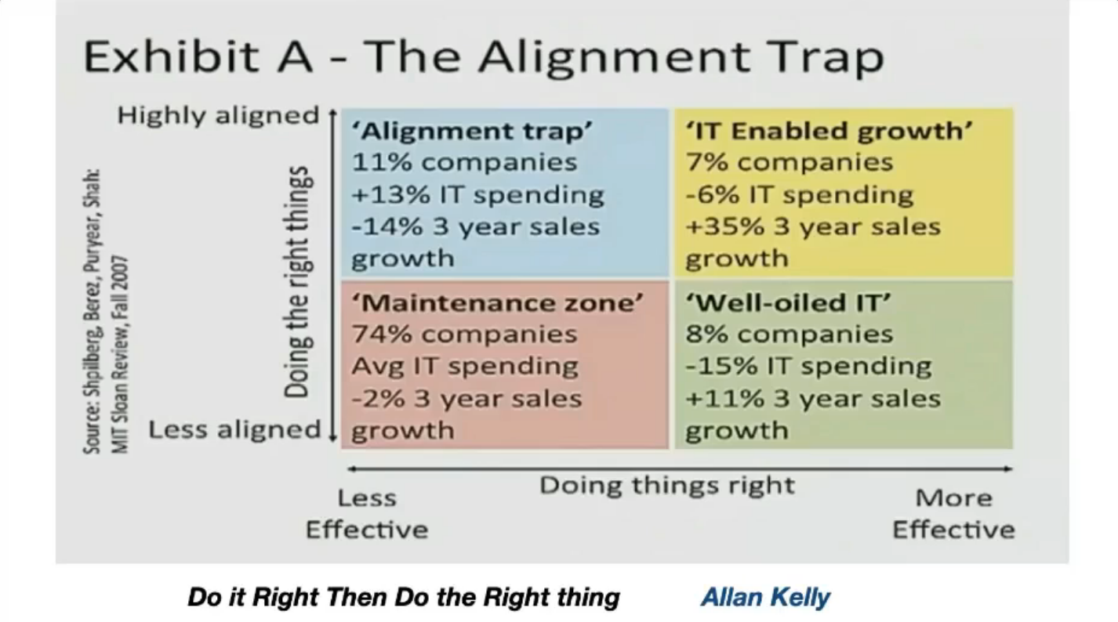

Slide 29
So, is Clean Code part of Software Quality?
Making a job right should be the responsibility of all of us
It’s even more important than delivering the right thing!
It pays off during the long run!

Slide 30
Who prevents us from writing clean code?

Slide 31

It's them, the project managers!
“Just keep delivering new features!”
“Many don’t even understand what technical debt is!”
“They don’t care about clean code as they don’t understand!”

Slide 32
Should PMs understand clean code?
Do they understand
Memory safety?
Concurrency patterns?
The different forms of polymorphism?
NO, IT’S NOT THEIR JOB!
Notes:
NO, IT’S NOT THEIR JOB! - different text box, big in the middle

Slide 33
It’s them, the junior developers!
“They don’t know how to code well”
“We don’t have the time to correct their code”
“They don’t arrive with good enough knowledge”
Notes:
They don;t arrive with 15 years of experience at the age of 23 either. What a disgrace!

Slide 34
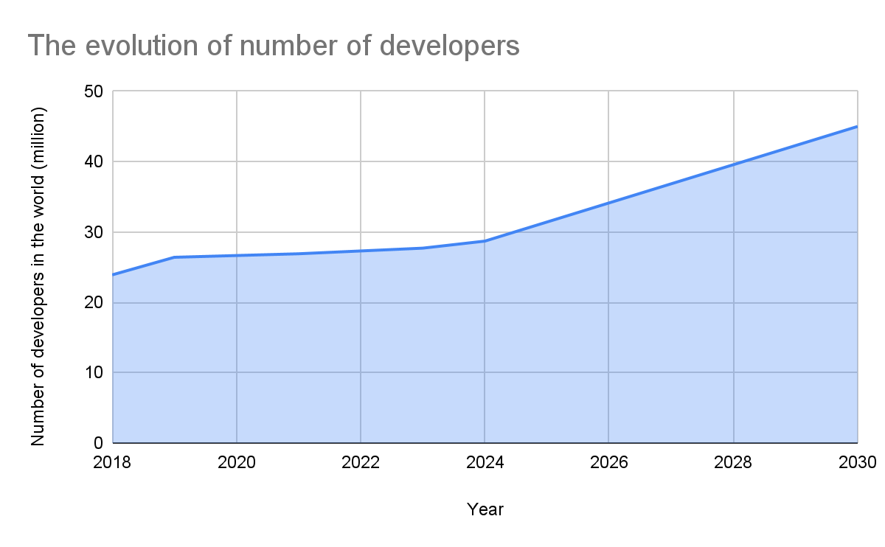
The number of juniors is exploding
The number of developers is rapidly growing
Not enough mentoring
Not enough mentors
Notes:
FIND NEW DATA SOURCE
https://www.bairesdev.com/blog/how-many-software-developers-in-the-world/ ->re 26.9 million software developers in 2021 — with 4.3 million of them in North America — a number that is expected to grow to 28.7 million in 2024.
https://www.allstarsit.com/blog/how-many-software-engineers-are-there-in-the-world
https://slashdata-website-cms.s3.amazonaws.com/sample_reports/EiWEyM5bfZe1Kug_.pdf
https://www.developernation.net/developer-reports/de20
https://docs.google.com/spreadsheets/d/1nYvn24KFN-WuBis6YoBhl4G2KtVGSoegeXbqO_bLHyk/edit#gid=0

Slide 35
IT’S US!

Slide 36


Clean code is hard, we must learn it!
Requires
Effort
Discipline
People are
Lazy
Disorganized
Notes:
Clean code doesn’t come with YoE

Slide 37
Let's do our job!
Notes:
Or What can we do?

Slide 38
But what is our job?
Notes:
Or What can we do?

Slide 39
Solving the problems of the business, it is.
Notes:
Mention survival code

Slide 40
What do we do to solve business problems?
Write (clean) code!
Write tests!
Tests are still code…
Notes:
Our job is to solve problem for the business

Slide 41
What do we do to solve business problems?
Write (clean) code!
Keep learning!

Slide 42
What do we do to solve business problems?
Write (clean) code!
Keep learning!
Communicate!

Slide 43
Our job is not only about coding!
We have to communicate!
Listen
Document
Educate
Notes:
Add some thoughts for each!

Slide 44
Educate by building a community
One swallow does not make a summer
You need at least a partner in crime
Teach by example
Educate through a growing community
The rest will take care of itself
Eventually you’ll have systems in place

Slide 45
Our job is not only about coding!
We have to communicate!
Listen
Document
Educate
Explain
Notes:
Add some thoughts for each!

Slide 46
Explain and offer alternatives
You might not need the full solution right away (YAGNI)
Break it down
Offer iterative solutions
They will lead to cleaner code
And overall, you might save some time

Slide 47
Our job is not only about coding!
We have to communicate!
Listen
Document
Educate
Explain
Alert
Notes:
Add some thoughts for each!

Slide 48
Our job is not only about coding!
We have to communicate!
Listen
Document
Educate
Explain
Alert
Say no!
Notes:
Add some thoughts for each!

Slide 49
We MUST say no - from time to time!
Oh, I think that plan is not going to work out well!
We have to remind them about the truth!
But do we have a mandate?
Yes and if they don’t trust you be ready to go!
Notes:
Make it look like a chat, bubbles in different colours on two sides

Slide 50
What can happen if you say NO?
Your objection might be heard
You might get convinced
It might get rejected
They might not care
Notes:
Might be heard, might not, the grumpy dev!

Slide 51
What can go wrong?
It’s just business
Nothing personal
It might show your way!
Step up or step out

Slide 52
Just do what you need to do

Slide 53
You’re the expert, don’t ask how to do your job
Do you tell your doctor how to cure you?
Do you want them to ask you how to cure you?
Do what you think is best
You are the expert

Slide 54
Conclusion
Quality is hard to define
Clean code is part of software quality
It’s part of our job to make the things right
It’s the seniors responsibility to pass on these values

Slide 55
Call to action
Explain
To you colleagues
To your (product) management
Set your limits
Be ready to say no
Lead your colleagues by example

Slide 56
Why Clean Code Is Not The Norm?
Sandor Dargo
T W I T T E R SandorDargo E M A I L sandor.dargo@gmail.com
Notes:
Main points are:
What is software quality & clean code
Their relationship
What can we do about them

